Slide 1
Registers

Slide 2
Registers
What is a Register?
Classification of registers
SHIFT REGISTER
Serial Input Serial Output (SISO)
Serial Input Parallel Output (SIPO)
Parallel Input Parallel Output (PIPO)
Parallel Input Serial Output

Slide 3
Register
A register is a group of memory elements that work together as a unit
The simplest register does nothing more than store a binary word.

Slide 4
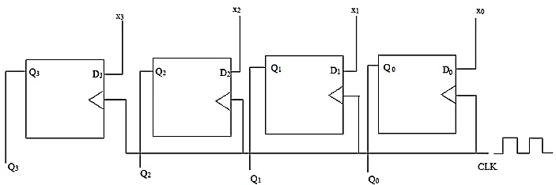
Buffer Register
It stores a digital word
A 4-bit buffer register stores 4 digital bits
Figure shows a 4-bit buffer register (positive edge triggered)
Here, Q₃Q₂Q₁Q₀ = X₃X₂X₁X₀

Slide 5
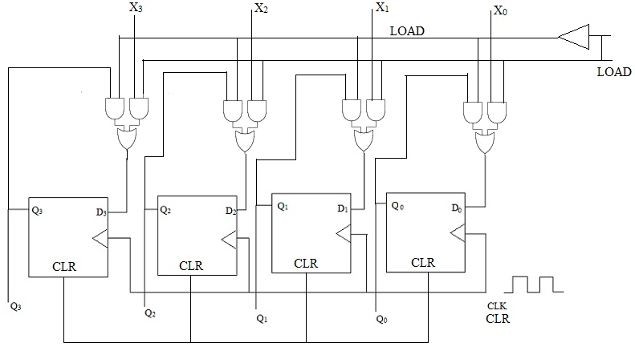
Buffer Register
It stores a digital word
Can be controlled by CLR, LOAD
When CLR goes high, all the FFs get reset
When CLR goes low, all the FFs are ready to work
If LOAD is low, FFs store the previous value
If LOAD is high FFs receive inputs and generate outputs

Slide 6
Shift Register
A shift register moves the stored bits either in the left or right direction
Two types
Shift left
Shift right

Slide 7
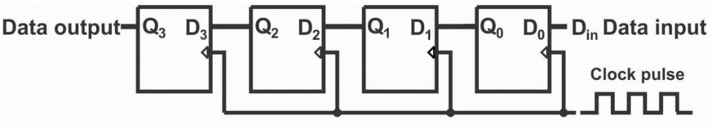
Shift Left Register
A shift register moves the stored bits in the left
Din sets up the right FF
Q0 sets up the next FF
This operation is sequentially operated

Slide 8
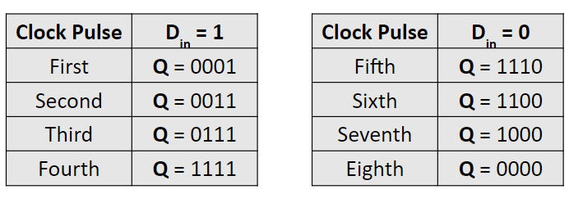
Shift Left Register
Initially, Q = 0000 and Din = 1

Slide 9
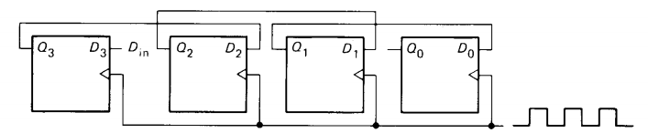
Shift Right Register
A shift register moves the stored bits in the right
Din sets up the left FF
Q3 sets up the previous FF
This operation is sequentially operated

Slide 10
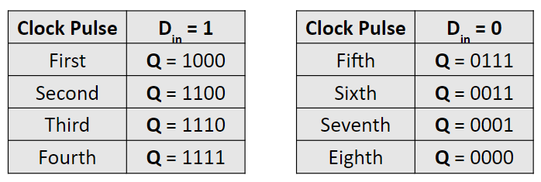
Shift Right Register
Initially, Q = 0000 and Din = 1

Slide 11
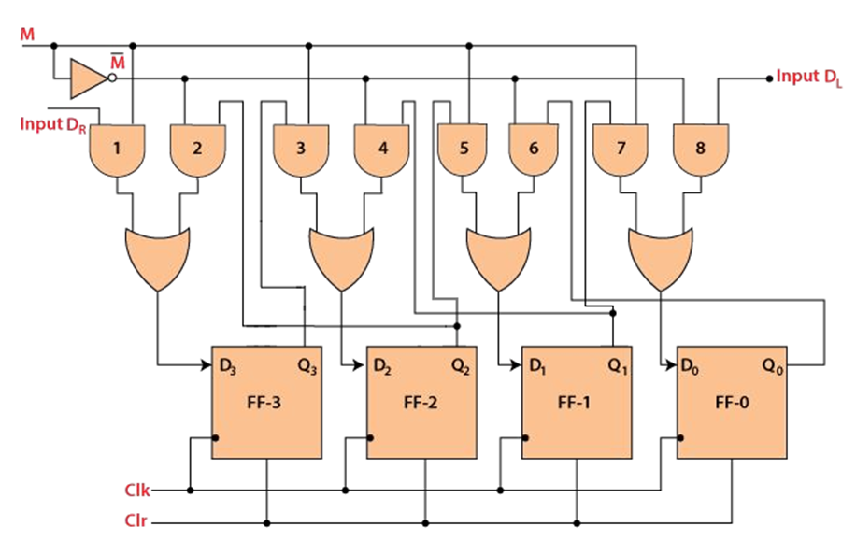
Bi-directional Shift Register
Option for both right shift and left shift.
M = 1 —---> Shift Right M = 0 —---> Shift Left

Slide 12
Serial and Parallel Loading

Slide 13
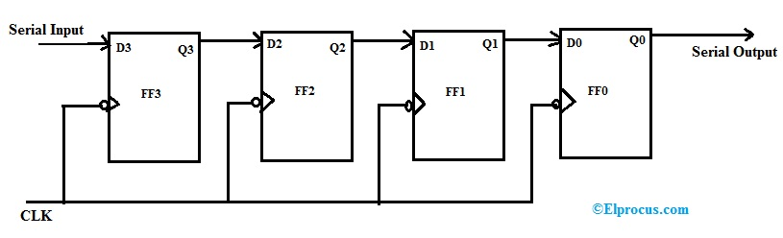
Serial Input Serial Output (SISO)
Serial Input Serial Output Register

Slide 14
Serial Input Serial Output (SISO)
Serial Input Serial Output Register
1011
We want to insert this data serially

Slide 15
Serial Input Serial Output (SISO)
Serial Input Serial Output Register
Clk | Q3 | Q2 | Q1 | Q0
 | 0 | 0 | 0 | 0
↓ | 1 | 0 | 0 | 0
↓ | 1 | 1 | 0 | 0
↓ | 0 | 1 | 1 | 0
↓ | 1 | 0 | 1 | 1
1011
0
0
0
0

Slide 16
Serial Input Serial Output (SISO)
Serial Input Serial Output Register
Clk | Q3 | Q2 | Q1 | Q0
 | 0 | 0 | 0 | 0
↓ | 1 | 0 | 0 | 0
↓ | 1 | 1 | 0 | 0
↓ | 0 | 1 | 1 | 0
↓ | 1 | 0 | 1 | 1
1011
1
0
0
0
0

Slide 17
Serial Input Serial Output (SISO)
Serial Input Serial Output Register
Clk | Q3 | Q2 | Q1 | Q0
 | 0 | 0 | 0 | 0
↓ | 1 | 0 | 0 | 0
↓ | 1 | 1 | 0 | 0
↓ | 0 | 1 | 1 | 0
↓ | 1 | 0 | 1 | 1
1011
1
0
0
0

Slide 18
Serial Input Serial Output (SISO)
Serial Input Serial Output Register
Clk | Q3 | Q2 | Q1 | Q0
 | 0 | 0 | 0 | 0
↓ | 1 | 0 | 0 | 0
↓ | 1 | 1 | 0 | 0
↓ | 0 | 1 | 1 | 0
↓ | 1 | 0 | 1 | 1
1011
1
1
0
0
0

Slide 19
Serial Input Serial Output (SISO)
Serial Input Serial Output Register
Clk | Q3 | Q2 | Q1 | Q0
 | 0 | 0 | 0 | 0
↓ | 1 | 0 | 0 | 0
↓ | 1 | 1 | 0 | 0
↓ | 0 | 1 | 1 | 0
↓ | 1 | 0 | 1 | 1
1011
1
1
0
0

Slide 20
Serial Input Serial Output (SISO)
Serial Input Serial Output Register
Clk | Q3 | Q2 | Q1 | Q0
 | 0 | 0 | 0 | 0
↓ | 1 | 0 | 0 | 0
↓ | 1 | 1 | 0 | 0
↓ | 0 | 1 | 1 | 0
↓ | 1 | 0 | 1 | 1
1011
0
1
1
0
0

Slide 21
Serial Input Serial Output (SISO)
Serial Input Serial Output Register
Clk | Q3 | Q2 | Q1 | Q0
 | 0 | 0 | 0 | 0
↓ | 1 | 0 | 0 | 0
↓ | 1 | 1 | 0 | 0
↓ | 0 | 1 | 1 | 0
↓ | 1 | 0 | 1 | 1
1011
0
1
1
0

Slide 22
Serial Input Serial Output (SISO)
Serial Input Serial Output Register
Clk | Q3 | Q2 | Q1 | Q0
 | 0 | 0 | 0 | 0
↓ | 1 | 0 | 0 | 0
↓ | 1 | 1 | 0 | 0
↓ | 0 | 1 | 1 | 0
↓ | 1 | 0 | 1 | 1
1011
1
0
1
1
0

Slide 23
Serial Input Serial Output (SISO)
Serial Input Serial Output Register
Clk | Q3 | Q2 | Q1 | Q0
 | 0 | 0 | 0 | 0
↓ | 1 | 0 | 0 | 0
↓ | 1 | 1 | 0 | 0
↓ | 0 | 1 | 1 | 0
↓ | 1 | 0 | 1 | 1
1011
1
0
1
1

Slide 24
Serial Input Parallel Output
The input process remains the same
We use wires to read out the values all together at a time

Slide 25
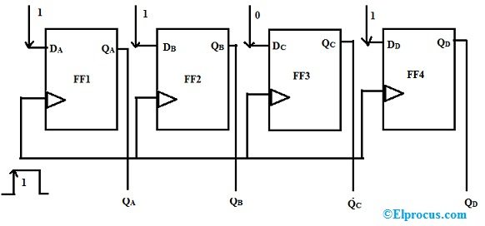
Parallel Input Parallel Output
Clock

Slide 26
Parallel Input Parallel Output
1
0
1
1
Clock

Slide 27
Parallel Input Parallel Output
1
0
1
1
Clock
1
0
1
1

Slide 28
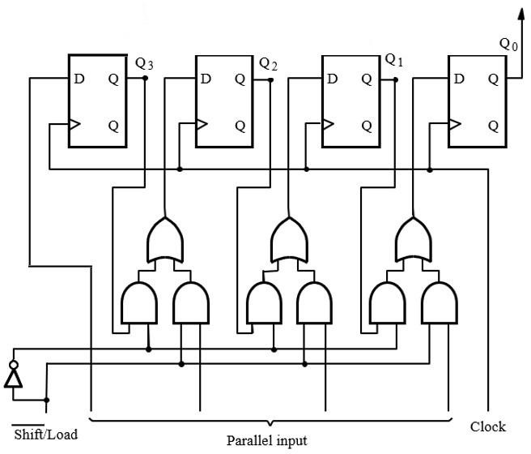

Parallel Input Serial Output
Two modes:
Serial Mode
Load Mode
When
Shift mode.
When
Load mode.
= 0, it works in
= 1, it works in
28

Slide 29
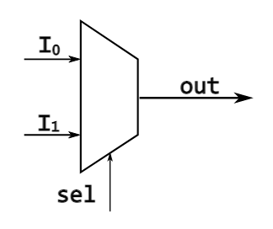
The Multiplexer Chip

Slide 30
The Multiplexer Chip
I₀
0

Slide 31
The Multiplexer Chip
I₁
1

Slide 32
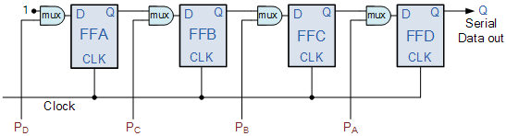
Parallel Input Serial Output

Slide 33
Parallel Input Serial Output
0 (load parallel input)
1
1
0
1

Slide 34
Parallel Input Serial Output
0 (load parallel input)
1
1
0
1

Slide 35
Parallel Input Serial Output
0 (load parallel input)
1
1
0
1
1
1
0
1

Slide 36
Parallel Input Serial Output
1 (shift)
1
1
0
1
1
1
0
1

Slide 37
Parallel Input Serial Output
1 (shift)
1
1
1
0
1
1
0
1

Slide 38
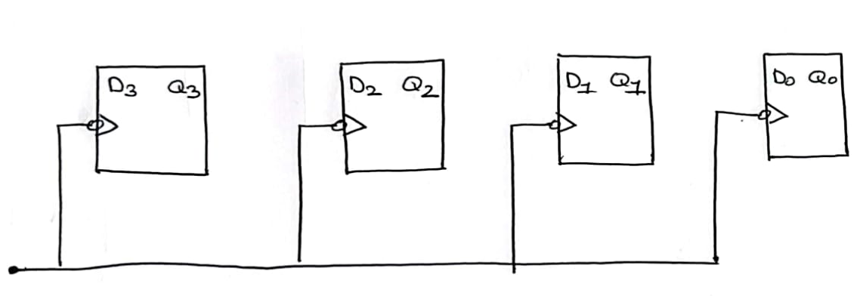
Bidirectional Shift Register Using MUX
Let us set the flip flops

Slide 39
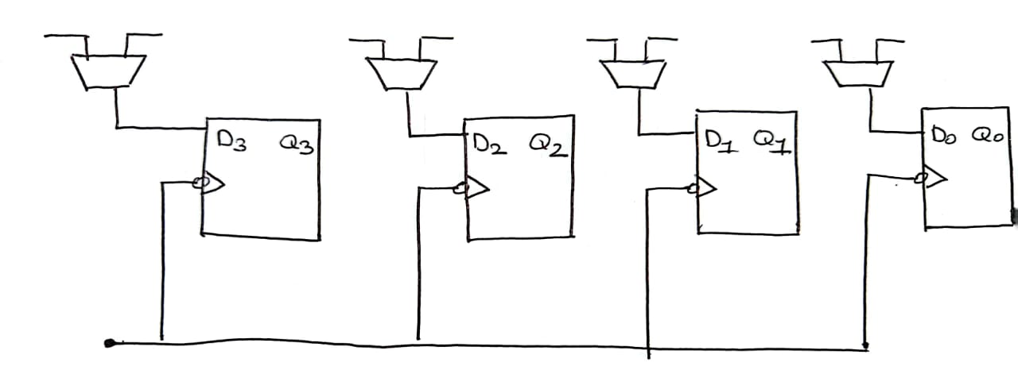
Bidirectional Shift Register
Next, let us set the multiplexers

Slide 40
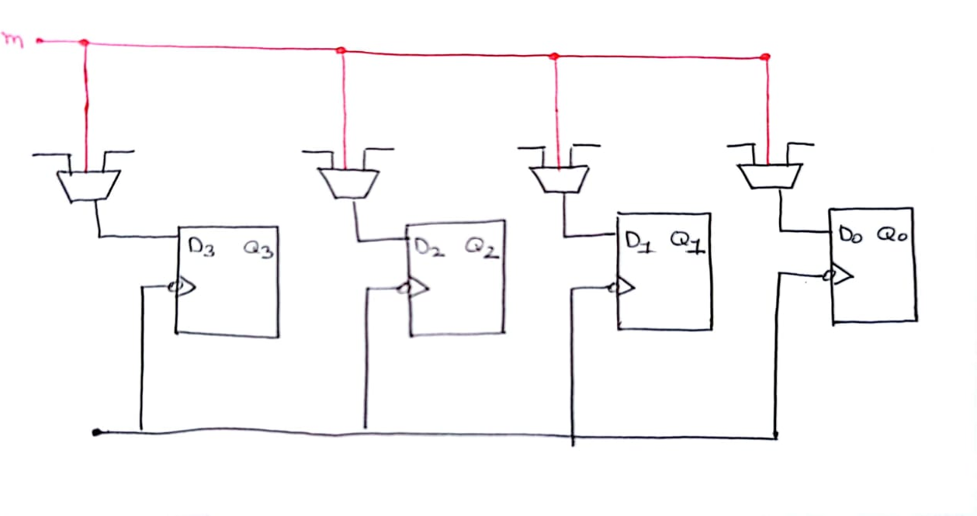
Bidirectional Shift Register
Next, let us set the multiplexers

Slide 41
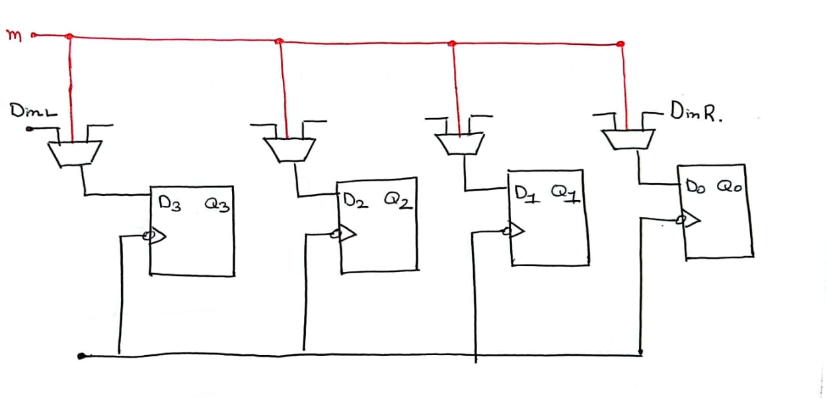
Bidirectional Shift Register
We can enter data from both sides
Din for Shift Right
Din for Shift Left

Slide 42
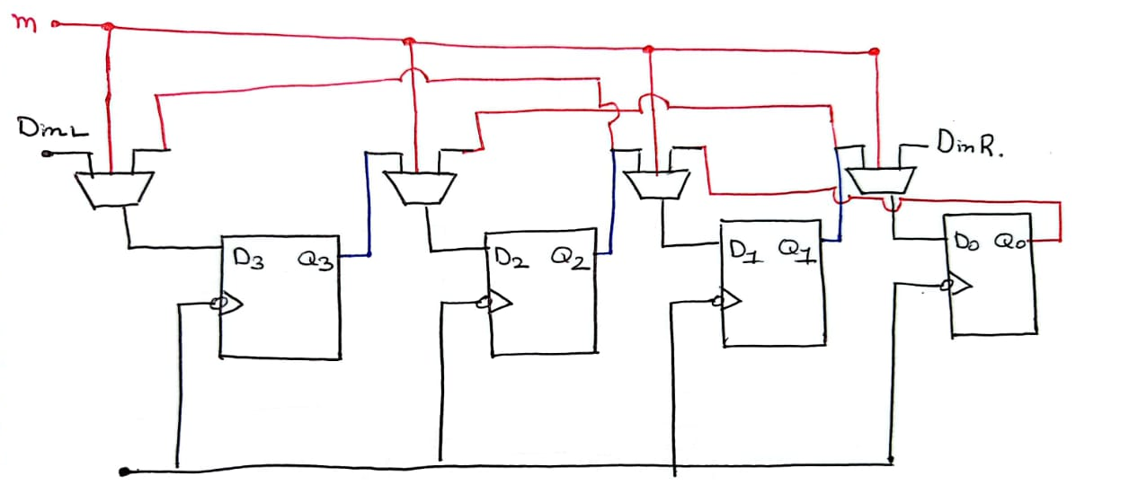
Bidirectional Shift Register
Din for Shift Right
Din for Shift Left

Slide 43
Bidirectional Shift Register
Din for Shift Right
Din for Shift Left

Slide 44
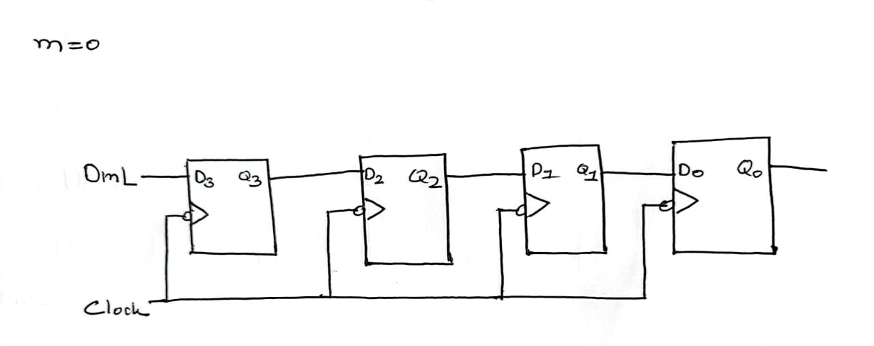
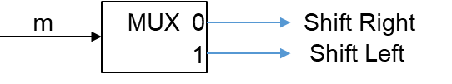
Bidirectional Shift Register
Din for Shift Right

Slide 45
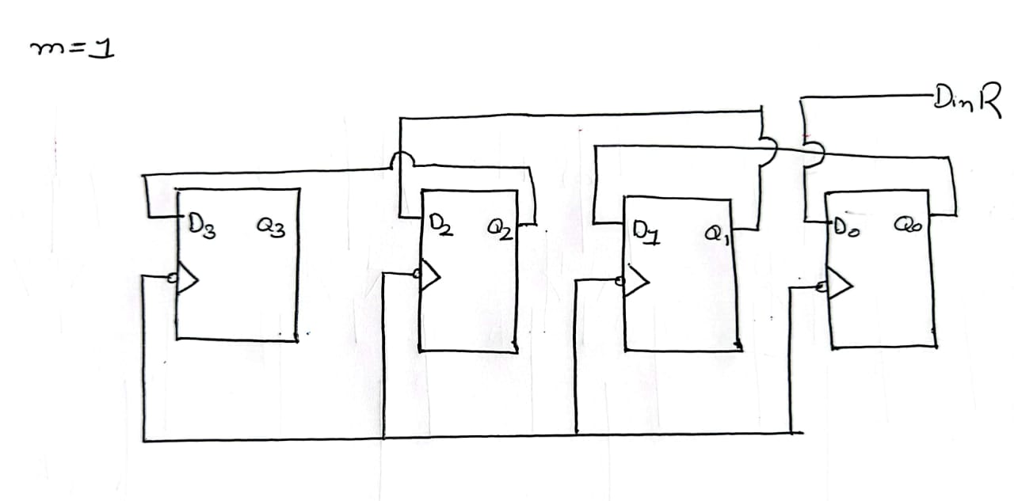
Bidirectional Shift Register
Din for Shift Left

Slide 46
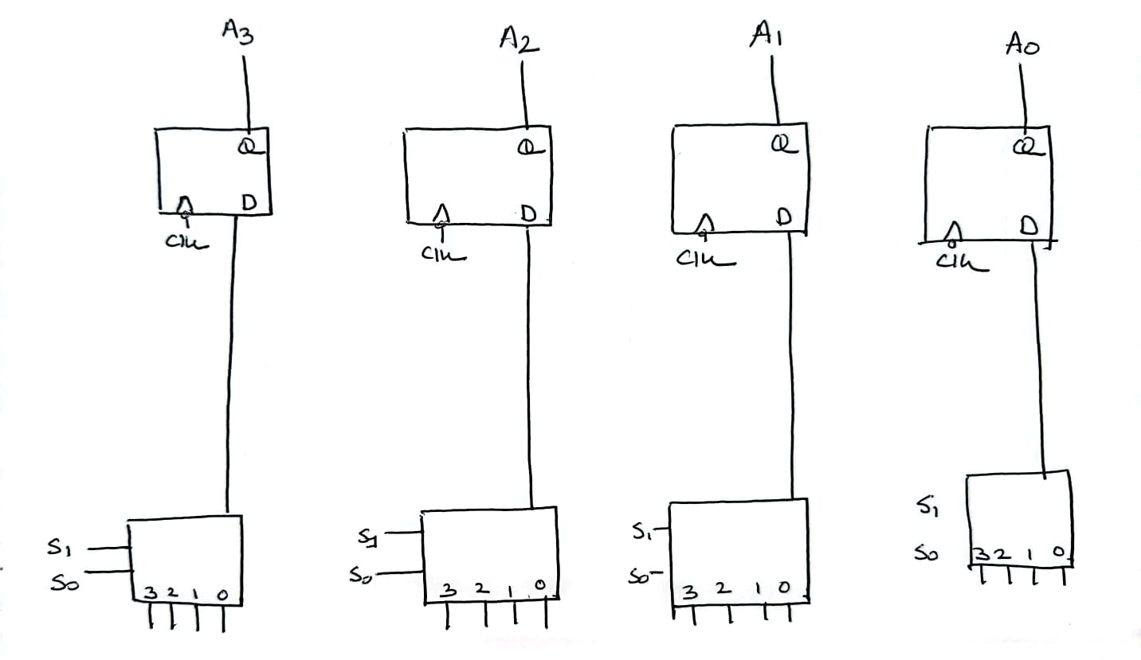
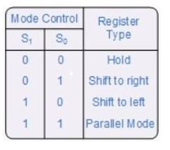
Universal Shift Register
Contains the capabilities of:
Right shift and left shift.
Parallel load.

Slide 47
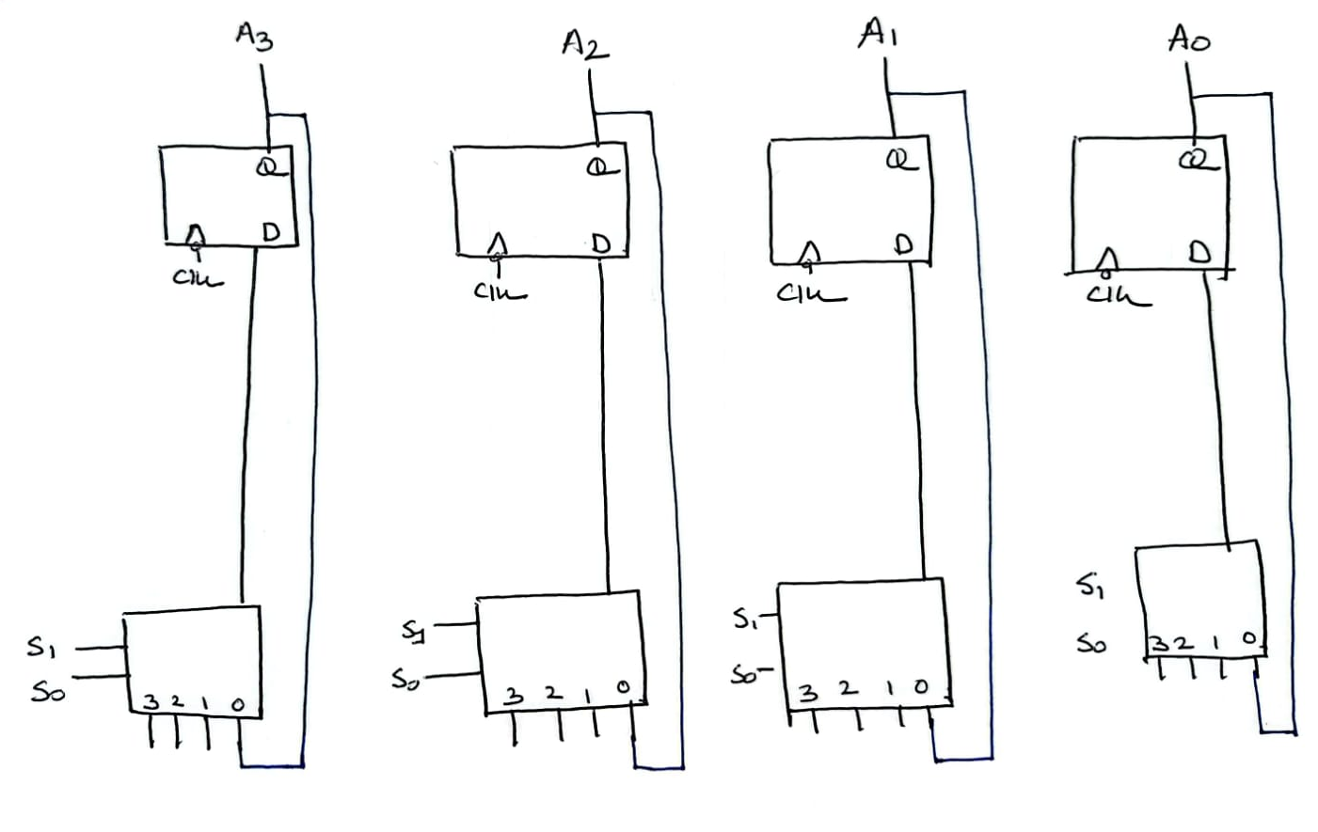
Universal Shift Register

Slide 48
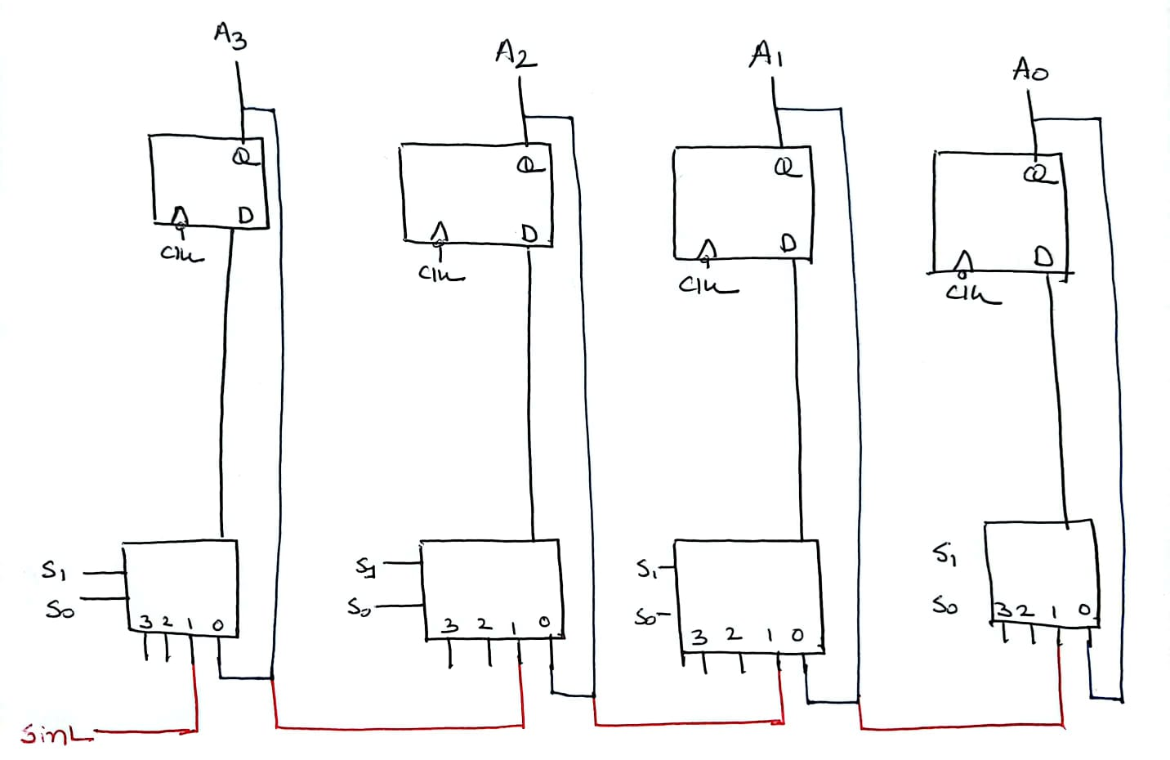
Universal Shift Register
Din for Shift Right

Slide 49
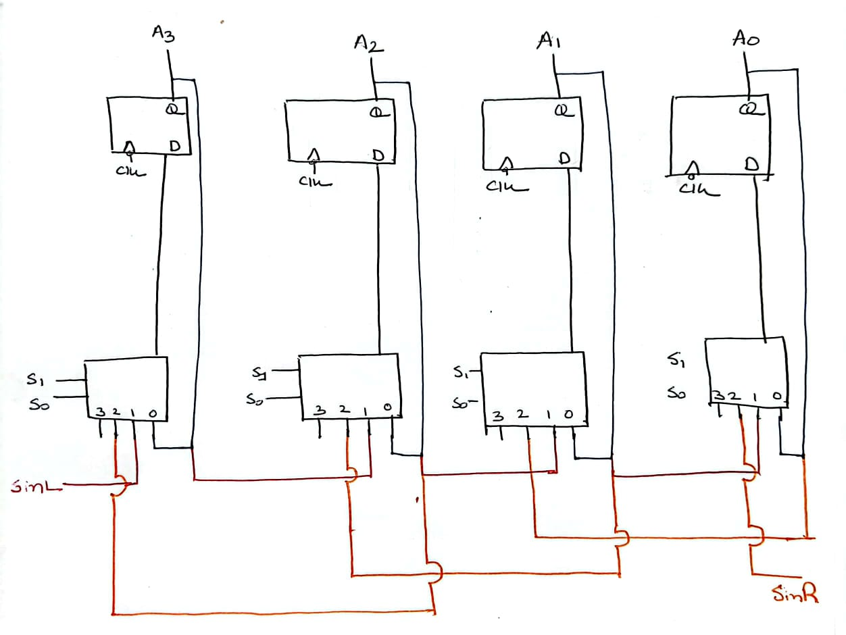
Universal Shift Register
Din for Shift Right
Din for Shift Left

Slide 50
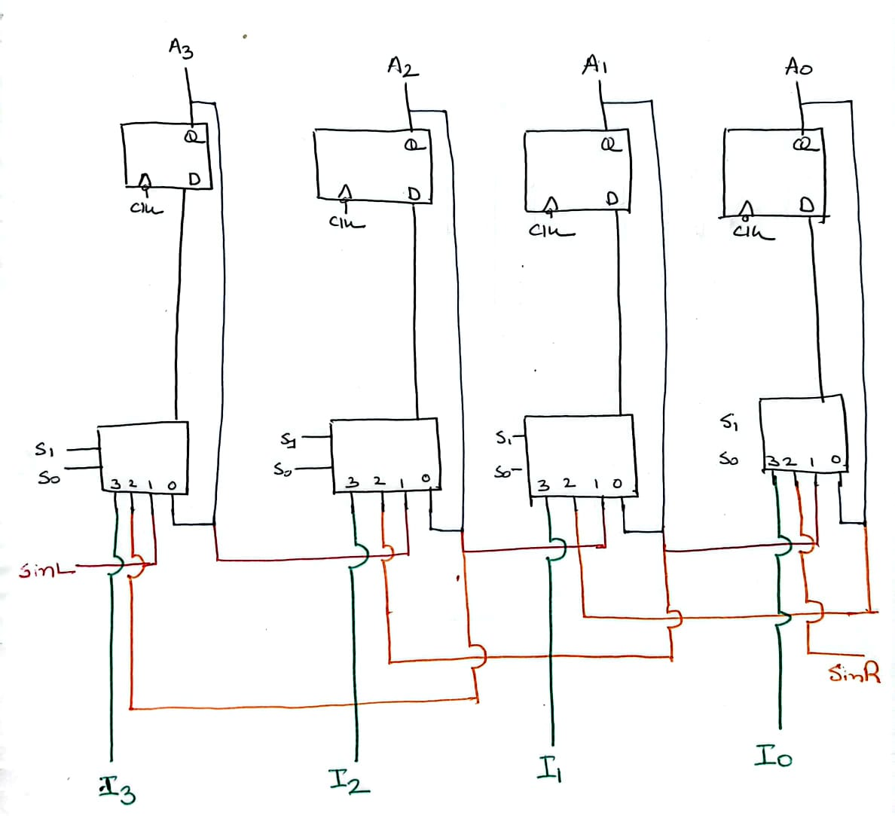
Universal Shift Register
Din for Shift Right
Din for Shift Left

Slide 51
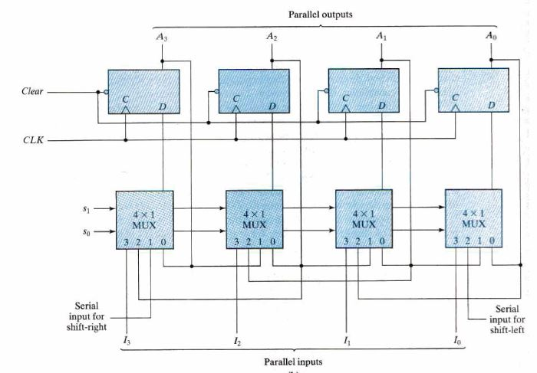
Universal Shift Register

Slide 52
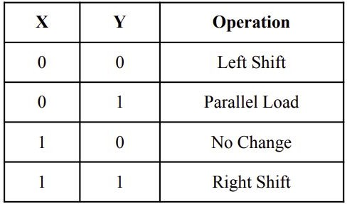
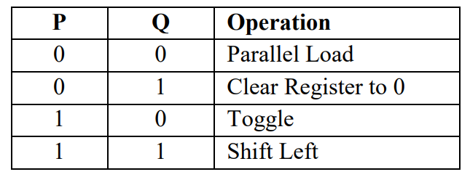
Universal Shift Register
try to draw the circuit for the following tables:

Slide 53
A PRELUDE
Encoder, Decoder, Multiplexer, Adder

Slide 54
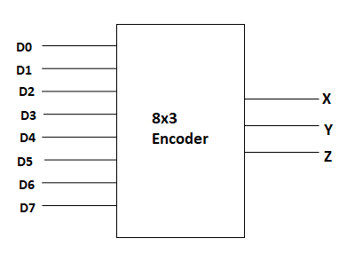
Encoder, Decoder, Multiplexer, Adder
Encoder

Slide 55
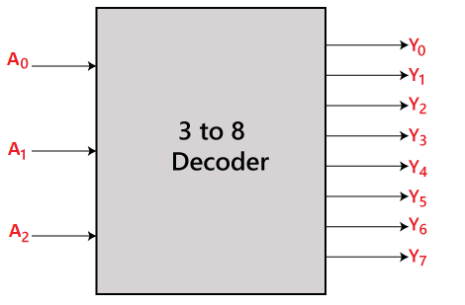
Encoder, Decoder, Multiplexer, Adder
Decoder

Slide 56
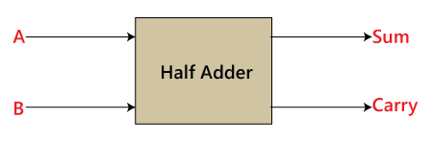
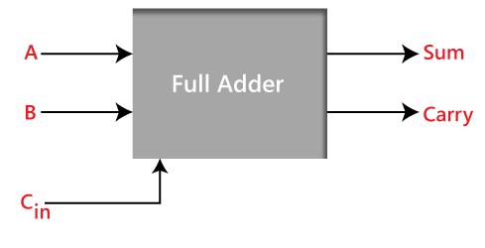
Encoder, Decoder, Multiplexer, Adder
Adder

Slide 57
Thank You

